Slide 1
Pivot Tables
Need HW and exam

Slide 2
Why?
A pivot table gives you a way to group, summarize and compare data in a spreadsheet.
You can do the same tasks with programming (COUNTIF and SUMIF), but they are much easier and faster with pivot tables.
Pivot tables really shine when applied to large file, but we will work with a small one.

Slide 3
Can…
Quickly summarize data
Calculate totals, averages, counts, etc. based on any numeric fields in your table
Make Data from table into charts

Slide 4
To start
Your data should be in a contiguous rectangular table. (Get rid of any blank rows or columns within the data .)
Every column should have a heading. (If you don't have any headers at all, right-click on the row number for the top row in the data field and choose "Insert" from the pop-up menu. You can then enter headers into the new row.)

Slide 5
Steps
Select your data range. (If you just select the upper left corner, and your data is contiguous and surrounded by blank rows and columns, Excel will figure it out.)
Insert the Pivot Table by going to the Insert tab and then clicking the Pivot Table icon.

Slide 6
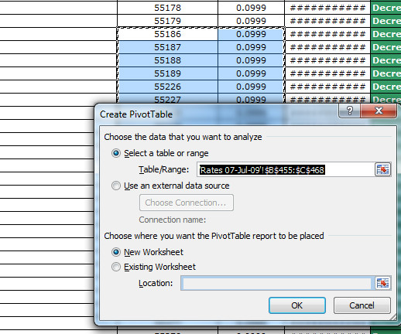
Steps
Choose where you want to place the pivot table. For starters, select the New Worksheet.

Slide 7
The new worksheet will open
You can now generate the report from this table
You can perform various operations on this table for better visualization and presentation of data.

Slide 8
Place a check mark next to any fields you want to include on the PivotTable on the "Field List" that appears on the right side of the Excel window.
See pivot 1. recall: it sums by default
As you add fields, Excel will automatically place them into one of the four PivotTable areas, represented by the four small boxes at the bottom of the "Field List." (next slide)

Slide 9
Column Labels: This area contains the fields that determine the arrangement of data shown in the columns of the pivot table.
Row Labels: This area contains the fields that determine the arrangement of data shown in the rows of the pivot table.
Values: This area contains the fields that determine which data are presented in the cells of the pivot table — they are the values that are summarized in its last column (summed by default).
Report Filter: This area contains the fields that act as the filters for the report. So, for example, if you designate the Year Field from a table as a Report Filter, you can display data summaries in the pivot table for individual years or for all years represented in the table.

Slide 10
Dragging
Instead of clicking the boxes by the field names, you can drag them to the boxes at the bottom
See pivot 2

Slide 11
Value field settings
Pivot 3 shows how many hours I taught each term.
To see how many courses I taught each term
Click on arrow in Values section.
Select Value Field Settings.
Choose Count to count the number of entries.
Could choose average, max, min, etc.

Slide 12
Subcategories
Add another row label, course.
Drag semester below course to see the difference.
The minus next to the label can be clicked to collapse it.
Unclick course to delete it (or drag it back up).

Slide 13
Pivoting
These things are called Pivot Tables.
"Pivot" means turn.
Let's change the axes. In pivot2 swap year and semester.

Slide 14
Filters
You can apply a filter to your data to only see selected items
See pivot filter. I chose only specific classes
You might want to only see entries greater than or less than a certain number, or the top 10 values, etc.

Slide 15
Filters
Pivot 2 Click on the arrow next to Row Labels and click on Value Filters.
Then click on >=. Type 100. OK. 2014 disappears cause only 90.
Instead choose Top 10
The box that appears gives you the choice of picking several things.

Slide 16
Filters
It allows you to select how many.
Select 1.
Leave Items unchanged as the next choice.
All we have is sum so leave that alone. OK.
Now it shows only 2 courses.
You can clear the filter so all the data shows again.

Slide 17
Pivot chart
Create a PivotChart
Open Pivot Table Tools Options tab.
Click Pivot Chart in the Tools Group.
Choose Clustered Column chart. Click OK.
Move the chart below the Pivot Table.
Save the workbook.

Slide 18
HW

Slide 19
Resources
http://www.dummies.com/how-to/content/the-essentials-of-excel-2010-pivot-tables-and-pivo.html
http://office.microsoft.com/en-us/excel-help/create-or-delete-a-pivottable-or-pivotchart-report-HP010342375.aspx
https://www.youtube.com/watch?v=l0a0dCgFA5g
I don’t get the table skeleton that he gets, but I can drag and drop into boxes
https://www.youtube.com/watch?v=qMGILHiLqr0
Put these in links on webpage

